Slide 1
Profit growth potential for FY2004
AdwentureWorks
Notes:
I'll present my insights in a 10 minute overview for 2004 profit growth potential

Slide 2
Presentation Outline
Sales shifts that led to last year’s profit growth.
Potential profit growth for next year.
* Sales data analyzed from July 1, 2001 to July 1, 2004
Notes:
Lets look at our profit growth last year

Slide 3
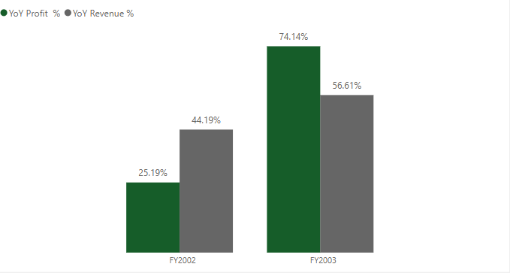
Huge Profit YoY Growth Last Year
Profit growth outpaced revenue – indicating improved margin efficiency.
Notes:
There is 3 things that led to this huge profit surge, first..

Slide 4
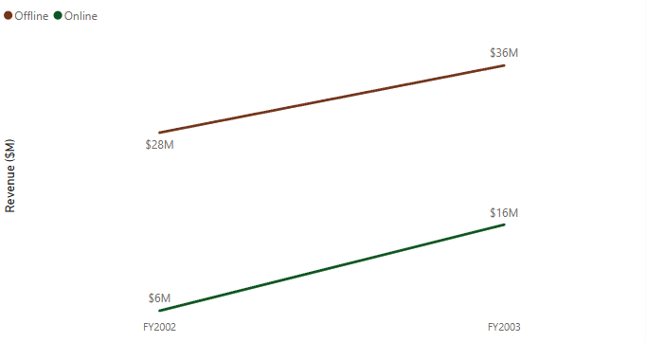
Strong Momentum in Digital Sales
Online sales have increased by 166% since 2002 – a sharp contrast to 28.7% growth in offline sales.
Notes:
But online sales didn’t just drive our revenue

Slide 5
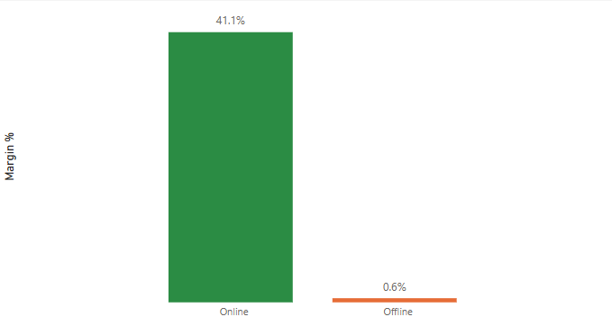
Online Channel Drives Profitability
Shift toward online channels enhanced overall margin performance.
Notes:
Second thing is growing sales in emerging countries

Slide 6
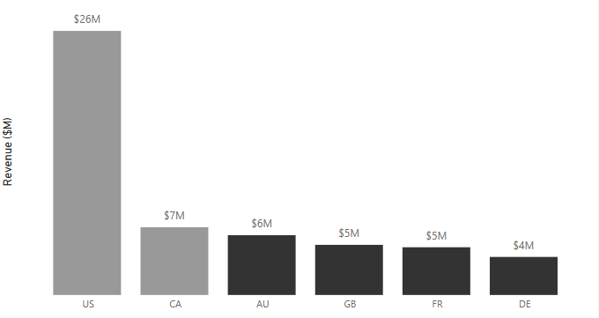
North America Market Leads in Revenue Contribution 2003
U.S. and Canada leads in revenue, with the highest performance across regions.
Notes:
But their profit growth is much slower than others

Slide 7
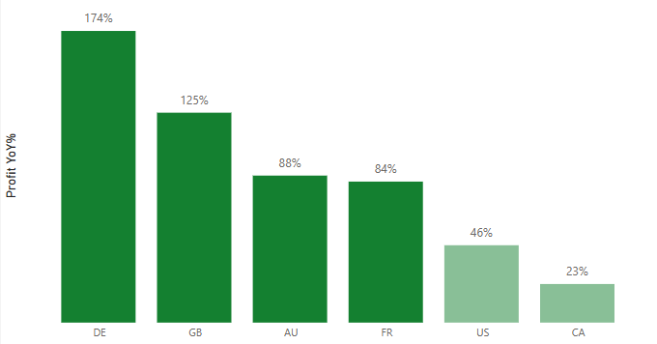
Profit Growth Shifted to Emerging Markets
U.S. profit growth is lagging, despite high overall revenue
Indicates improving efficiency and profitability outside the U.S.
Notes:
Countries like Denmark, Great Britain, Australia, France gaining ground, same countries also have the highest margins

Slide 8
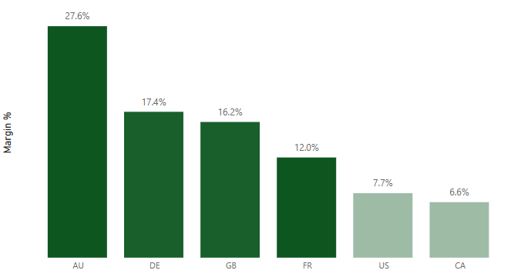
High-Growth Markets Deliver Superior Margins
Emerging markets combined rapid growth with strong efficiency.
Notes:
Indicates scalable and sustainable profit models in these regions.
Third thing that lead to profit growth last years is acecories and bikes in product categories

Slide 9
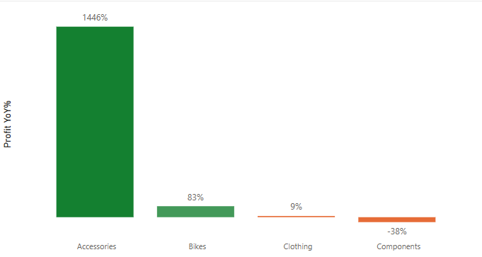
Accessories Lead YoY Profit Growth, Bikes Follow
Accessories followed by Bikes led in profit growth.
Other categories showed negligible changes in profit.
Notes:
If we look at the total generated profit

Slide 10
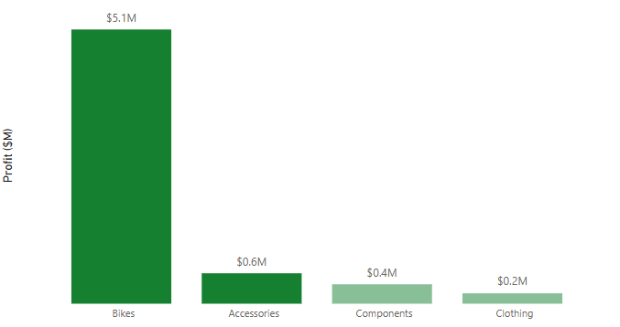
Bikes and Accessories Drive Profitability
Bikes category dominates with the highest profit contribution.

Slide 11



Key Takeaways from 2003
Online sales are driving profit growth.
Profit growth shifts to emerging markets.
Bikes and Accessories were the main contributors to profit growth.
Notes:
Despite having great year last year, there is much potential for profit improvement, first lets dive deeper into our leading product in sales, Bikes

Slide 12
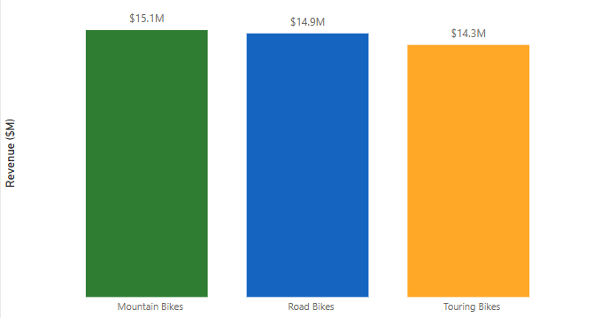
Balanced Revenue Share in Bike Subcategories
Bike subcategories show equal distribution of revenue.
Notes:
Indicates a diverse customer demand across bike types

Slide 13
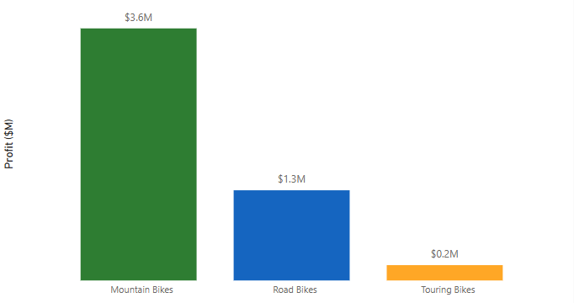
Profit Potential in Bike Subcategories
Touring and road bikes could be optimized for higher profitability.
Notes:
Because there is a serious problem with offline operations for touring and road bikes

Slide 14
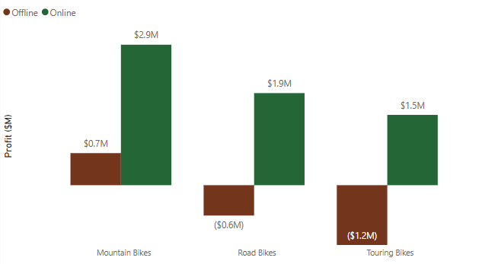
Offline Sales Generates Negative Profit for Road and Touring Bikes
Road bikes and touring bikes show untapped potential in offline sales, with negative profits.
Notes:
So solving this problem could unlock huge profit potential

Slide 15
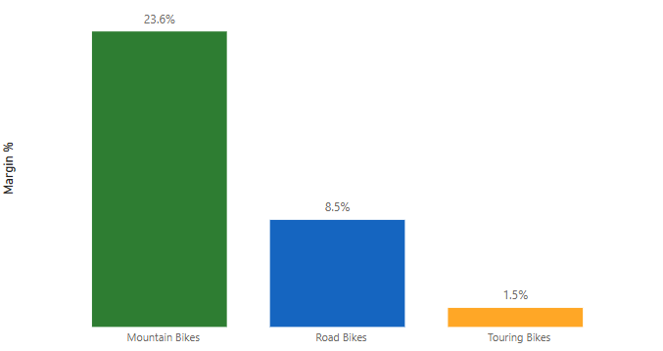
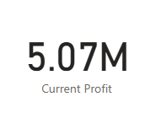
Profit Potential for Road and Touring Bikes
Focus on offline sales optimization could significantly increase profitability.
Notes:
Last year they bikes generated 5.07 millions,
If we manage to move margin rates for road and touring bikes to 10% which is still way lower than mountain bikes

Slide 16
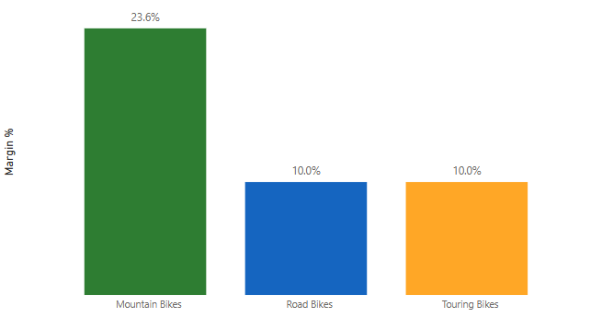
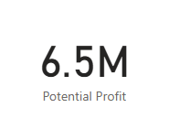
Profit Potential for Road and Touring Bikes
Raising margin rates to 10% for road bikes and touring bikes could unlock an additional $1.5M in profit.
Notes:
Which is almost 25% of our total profit last year, really huge potential. Next lets look at our 2nd best sales product category

Slide 17
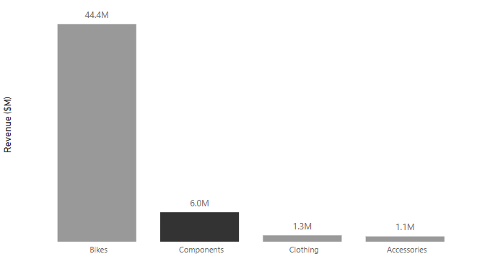
Components: Second in Revenue with Profit Potential
Components is the second-highest revenue-generating product category.
Notes:
But..

Slide 18
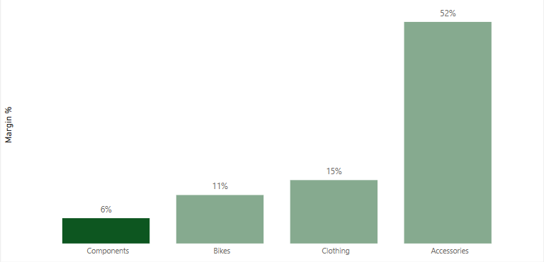
Underperforming Margin in Components – A Growth Lever
Despite second in sales, Components have the lowest profit margin in product categories.
Notes:
So there is potential to increase profitability through margin improvement. If we dig deeper in subcategories

Slide 19
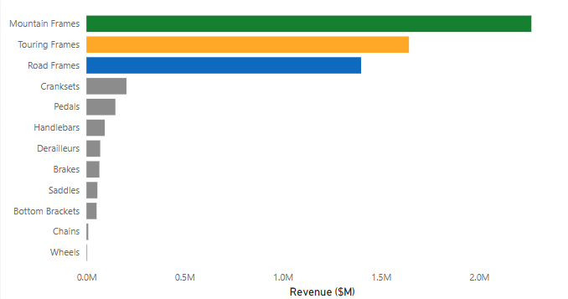
High Revenue Products with Profit Potential
Mountain, Touring and Road Frames are among the highest revenue-generating products.
Notes:
By focusing on high-performing products, we can unlock their full profit potential. Because margin rates show that…

Slide 20
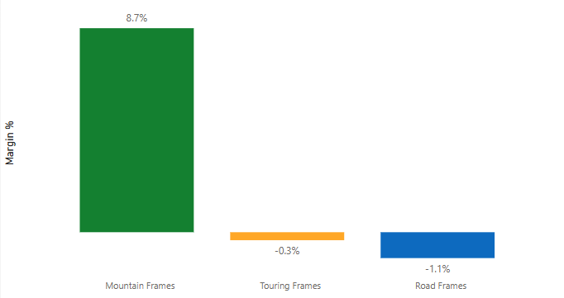
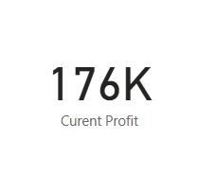
Upside Potential with Margin Improvements
Touring and Road Frames currently generate negative profit, lowering total gains.
Notes:
Together they generated 176k profit last year, if we work on improving margins to 5%

Slide 21
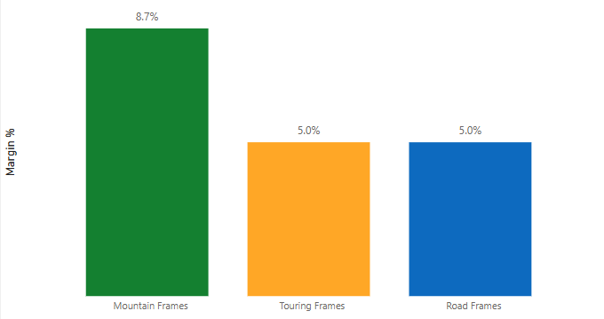
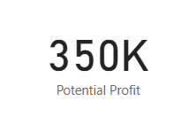
Upside Potential with Margin Improvements
Raising margin rates to 5% for road and touring frames could unlock an additional $130K in profit.
Notes:
Which is almost double profit from these 3subcategories.
So the main goals for increasing profit next year should be..

Slide 22

Strategic Focus 2004
Scale online sales, optimize offline operations.
Expand in high-growth regions.
Unlock profit in Bikes and Components category.
Notes:
Online sales have a amazing 41% profit rate, while offline operations is lacking behind
2. Who also have the best margin rates
3. With the same sales amount., aising margin rates in these subcategories could unlock almost 2millions additional profit next year.

